Slide 1
Article III U.S. Constitution

Slide 2
The Judicial Branch
Article 3 of the U.S. Constitution establishes a court system led by the U.S. Supreme Court in Washington, DC

Slide 3
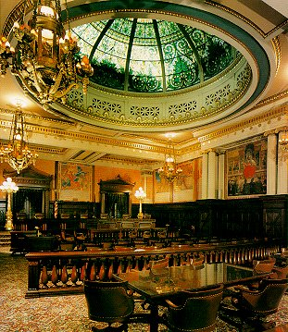
The Judicial Branch
JOB:
To interpret, or explain, the laws.
To determine if laws are fair or legal.
To determine if there is evidence that a law was broken.
Nine Justices serve: 8 Associate Justices and 1 Chief Justice.

Slide 4
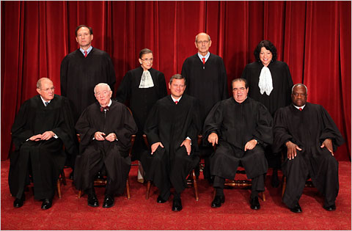
The Judicial Branch
Each Justice is appointed by the President and approved by the Senate.
Justices serve for life, or until they retire.
Only death, voluntary retirement, or impeachment for gross misconduct can remove a Justice.

Slide 5
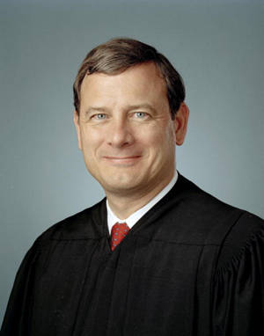
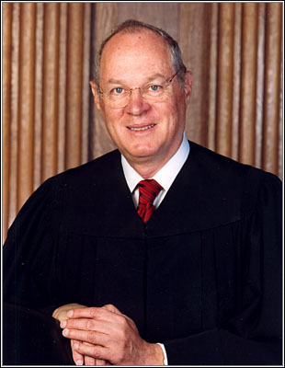
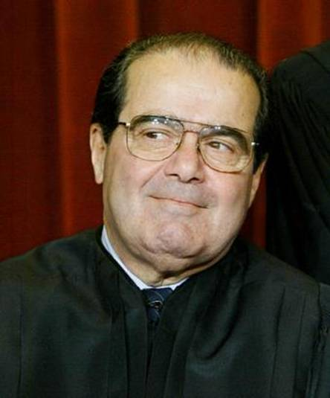
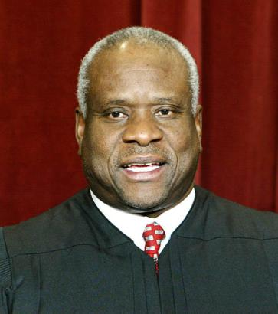
The Supreme Court Justices
Chief Justice
John Roberts
Justice
Anthony Kennedy
Justice
Antonin Scalia
Justice
Clarence Thomas
Justices are appointed by the President and must be approved by the senate.

Slide 6
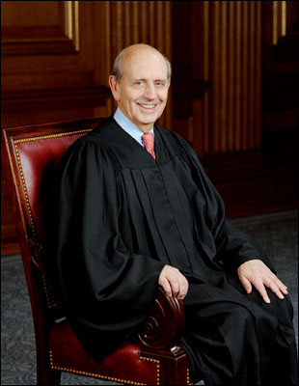
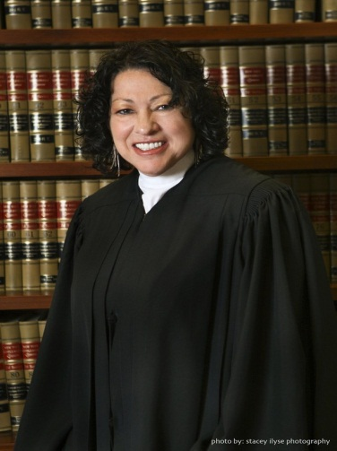
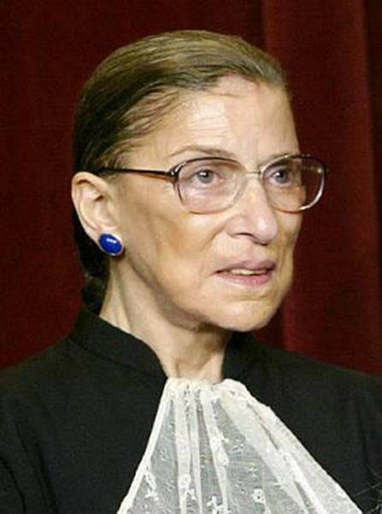
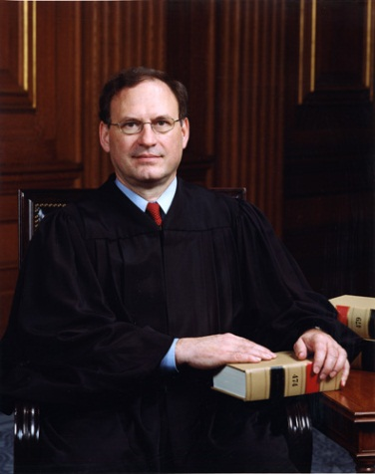
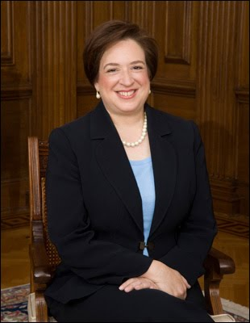
The Supreme Court Justices
Justice
Stephen Breyer
Justice
Ruth
Bader Ginsburg
Justice
Samuel Alito
Justice
Sonia Sotomayor
Justice
Elena Kagan

Slide 7
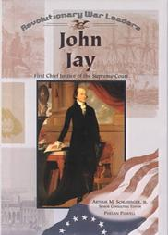
The Judicial Branch
John Jay was the first Chief Justice of the US Supreme Court.

Slide 8
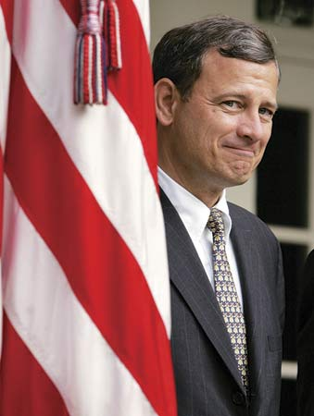
The Judicial Branch
John Roberts is the current Chief Justice.

Slide 9
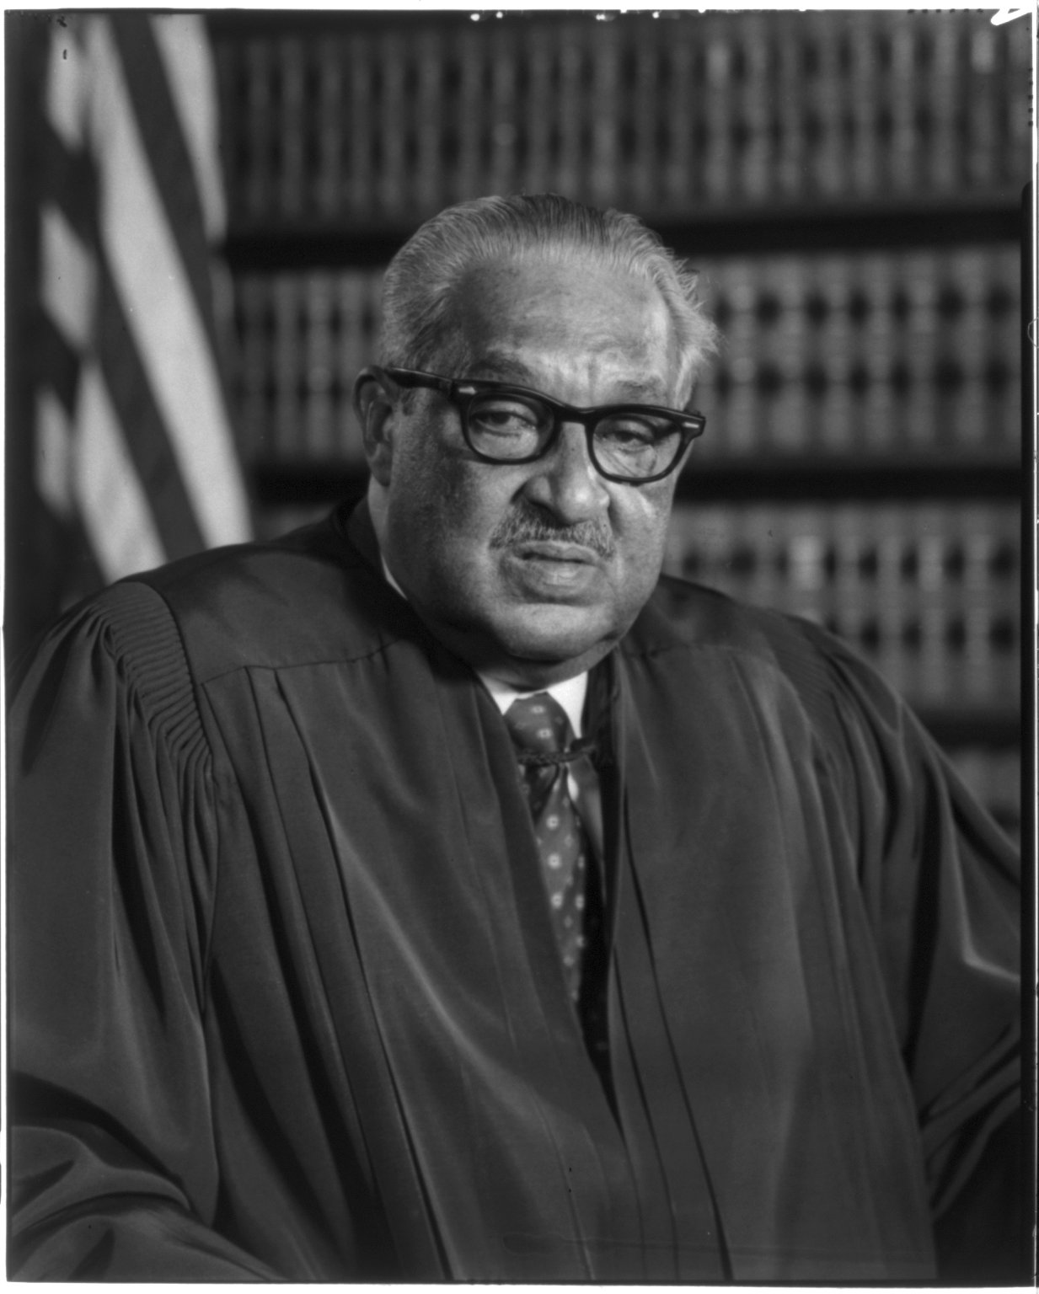
The Judicial Branch
Thurgood Marshall was the first African American to serve on the High Court.

Slide 10
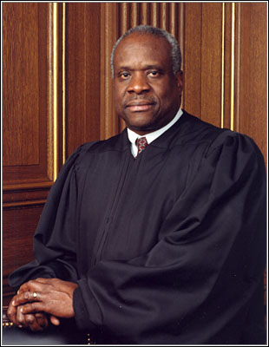
The Judicial Branch
Today, Clarence Thomas is the only African American serving on the Supreme Court.

Slide 11
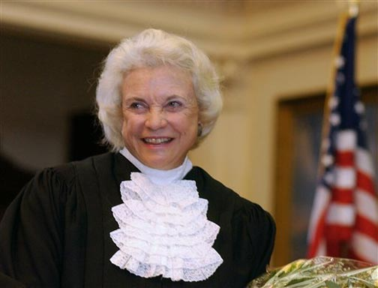
The Judicial Branch
Sandra Day-O’Connor was the first woman to serve on the Supreme Court.

Slide 12
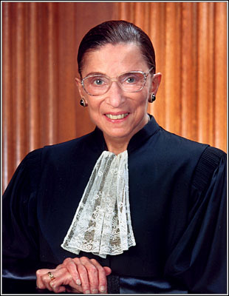
The Judicial Branch
Justice
Ruth
Bader Ginsburg
Justice
Sonia Sotomayor
Justice
Elena Kagan
Today, there are 3 woman serving on the Supreme Court.

Slide 13
The Judicial Branch
The Federal Court System has 91 DISTRICT COURTS, where most cases begin.
After being heard in a District Court, a case may go to a Federal APPELLATE COURT – there are 12 U.S. Appellate Courts in the USA.
If necessary, the case may move up to the U.S. Supreme Court. This is the Highest Court in the Land.

Slide 14
The Judicial Branch
States also have court systems based on the same model:
Circuit courts;
Appellate Courts; and a
State Supreme Court.
Cases that have been heard by a State Supreme Court may also move up to the U.S. Supreme Court.

Slide 15
The Judicial Branch
The U.S. Federal Court System
U.S. Supreme Court
12 Appellate Courts
91 Federal District Courts

Slide 16
The Judicial Branch
State
Supreme
Courts
The U.S. Supreme Court
State vs. State
Federal Appellate Courts
Cases involving
The military
Federal District Courts
Cases involving the
U.S. Constitution
The U.S. Supreme Court hears many types of cases.

Slide 17
The Judicial Branch
Only 5 Justices (a majority) need to agree on a case that is being heard.
Once a decision is made, the majority side writes an official statement called a Ruling or Decision.
Those Justices who voted in the minority also write a statement called the Dissenting Opinion.

Slide 18
The Judicial Branch
Federal courts and the U.S. Supreme Court hear cases involving …
… the Constitution;
… Federal laws;
… treaties;
… laws governing ships

Slide 19
The Judicial Branch
The courts may also hear cases coming from the people concerning …
… the U.S. government;
… two or more state governments;
… citizens of different states;
… a state or its citizens versus a foreign country or a foreign citizen.

Slide 20
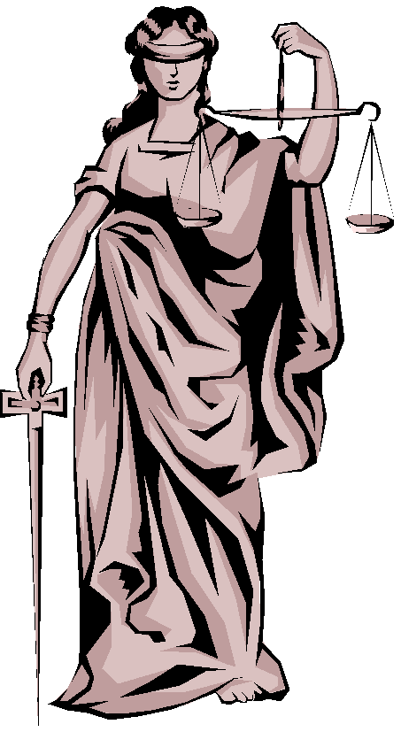
The Judicial Branch
Writ of Certiorari … a formal request to the Supreme Court to hear a case.

Slide 21
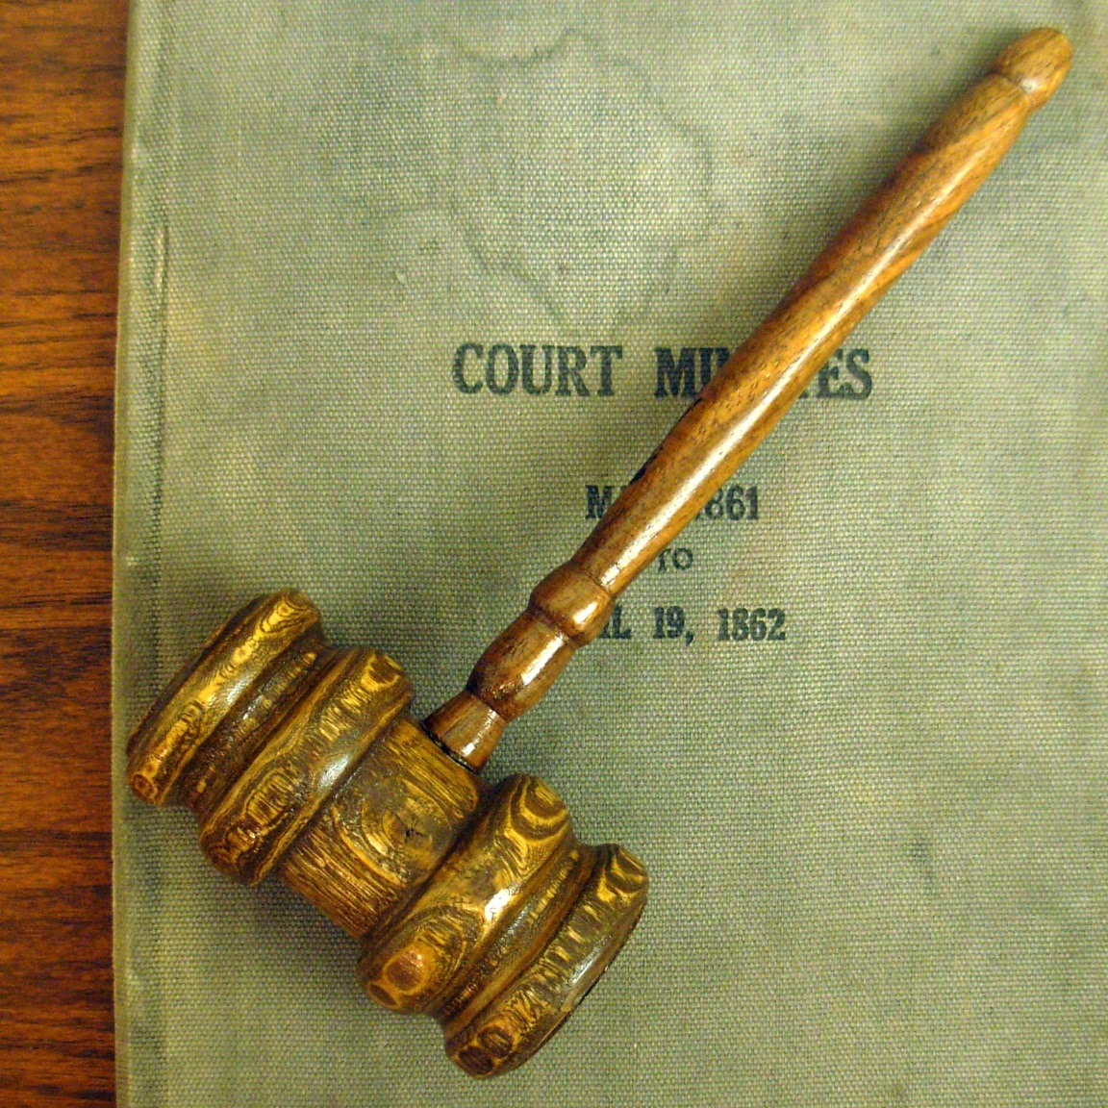
The Judicial Branch
Judicial Review … that special power of the Supreme Court to study a law and declare it “unconstitutional.”

Slide 22
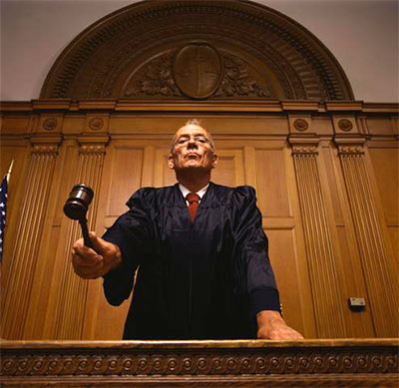
Original Jurisdiction
Original Jurisdiction is WHERE a case is heard for the first time.
Only courts with Original Jurisdiction have the right to hear a case first.
The U.S. Supreme Court has limited types of cases that fall under Original Jurisdiction.

Slide 23
Types of Cases (Original Jurisdiction) – U.S. Supreme Court
Cases involving…
…The U.S. Constitution
…Federal Laws
…Treaties
…Laws governing ships
…The U.S. Government
…Citizens from different states
…State vs. State
…A state or its citizens vs. a foreign nation

Slide 24
Treason
Treason is the act of a U.S. citizen carrying on war against the United States and giving help to a nation’s enemies.
To be convicted of Treason two witnesses must attest to the same story, and/or the accused must make a confession in a courtroom.

Slide 25
Checks and Balances
The Supreme Court can affect:
The Executive branch by:
Creating court orders that require some action by the President or Congress in order to enforce or remove an existing law.
Having the Chief Justice Act as the judge during an impeachment trial.
The Legislative Branch by:
Declaring laws to be unconstitutional and therefore unenforceable.

Slide 26
Checks and Balances
The Supreme Court can be affected:
By the Executive branch:
The President appoints Justices, and can influence the court by doing so.
By the Legislative Branch:
Justices must be confirmed by the Senate before their appointment by the president is final.

Slide 27
The Judicial Branch-Key Terms
Appeal
Defendant
Plaintiff
Grand jury
Indictment
Original jurisdiction
perjury
verdict

Slide 28
The Judicial Branch-Key Court Cases
Plessy v Ferguson
-Summary
Brown v Board of Education
-Summary
Roe v Wade
-Summary

