Slide 1
pH Test Kit

Slide 2
Task
Deaths related to food safety are a major source of fatalities worldwide.
Simple and reliable methods of preserving food are critical in high poverty environments.
To ensure safety and minimize the use of materials, design an acidity test kit that is cheap (<$0.50), durable and reliable to indicate if an acidic preservative liquid has the correct pH to preserve food.

Slide 3
Problem Statement
Who, What, Why
People in poverty around the world need a way to test the pH of preservative solutions to ensure food safety while saving money and materials.

Slide 4
Background research
pH strips: dye soaked paper is dried, and a color coded chart is provided. The test strip is dipped in what is being tested, and the resulting color is compared to the chart to determine the matching pH.
pH Meter: two electrodes are dipped in the solution being tested, and an electrical current is passed between them. Based on resistance, the meter calculates the pH of the solution and displays it digitally.
pH drops: Drops of a pH indicator are added to a sample. The resulting color is then compared to a chart to determine the matching pH.

Slide 5
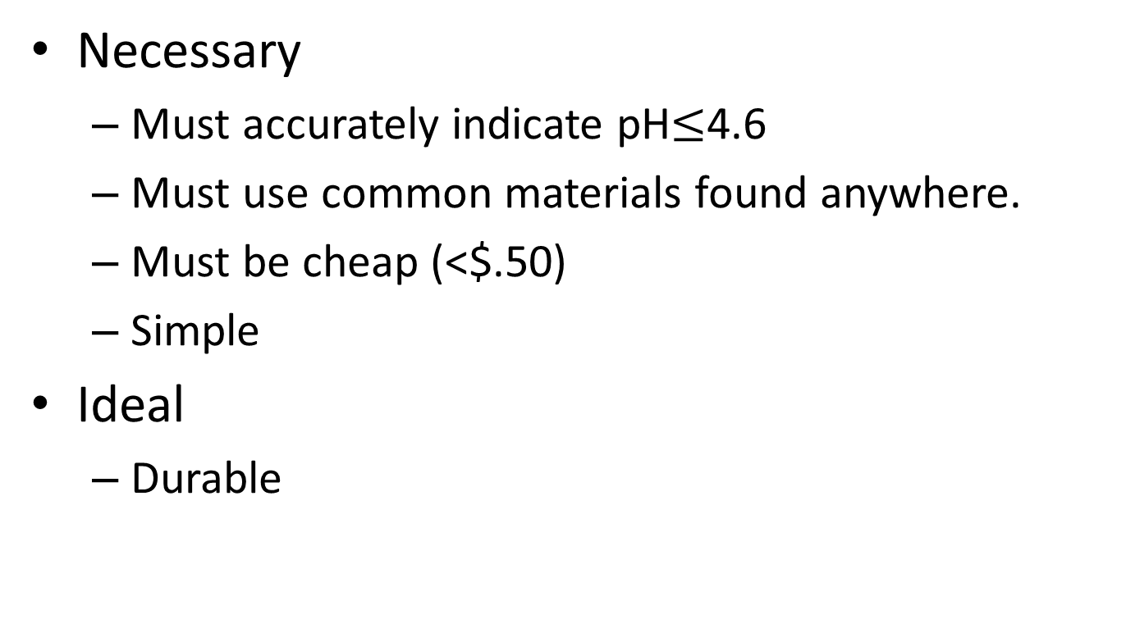
Requirements
Necessary
Must accurately indicate pH$≤$4.6
Must use common materials found anywhere.
Must be cheap (<$.50)
Simple
Ideal
Durable

Slide 6
Brainstorm!
What will you make?
What materials will you need?
How will you test it?
Share and troubleshoot
Model
Draw/Sketch
Storyboard how it should be used (comic directions.)

Slide 7
Troubleshooting
How will they know what color to compare to? How can they be certain that the color their indicator that they made is the right color to be pH lower than 4.6?

