Slide 1
Cell reproduction: division
Mitosis vs. Meiosis

Slide 2
Chromosomes
DNA does not float freely, but is instead organized into groups. These groups are usually invisible to microscopes, because the DNA chains are too small and spread out.
During cell replication, these DNA groups clump together. When dyed under a microscope, they form colored bodies. (Greek: chroma=colored, soma=body.) They are therefore called chromosomes.

Slide 3
Chromosomes
Technically, a chromosome refers to a group of (usually related) genes that are physically attached into one large body.
In (typical) Eukaryotes, chromosomes are linear clusters of DNA.
In (typical) prokaryotes, chromosomes are loops or circles of DNA.

Slide 4
Chromosomes
Each chromosome has a different set of genes.
Organisms can have different numbers of chromosomes, as well as different numbers of genes.
The common fruit fly has 14000 genes grouped into a total of 4 chromosomes.
Humans have 23000 genes spread over 23 chromosomes.

Slide 5
Chromosomes: types
Sex Chromosomes – Sex chromosomes determine the gender of an organism. This may be accomplished by the presence or absence of a sex chromosome (as in the Y chromosome in humans,) the ratio of a certain sex chromosome to autosomes, or even by environmental activation of certain genes.
Autosomes – Most chromosomes are autosomal. All non-sex chromosomes are autosomes.

Slide 6
Chromosomes: haploid
A chromosome carries a given group of genes.
An organism can have multiple types of chromosomes, each with a different group of genes. Chromosome 1, Chromosome 2, etc.
When a cell has just one of each type of chromosome (One chromosome 1, one chromosome 2, etc.) it is usually called haploid.

Slide 7
Chromosome: Diploid
When a cell has two versions of each type of chromosome (Two of chromosome 1, two of chromosome 2, etc.) it is usually called diploid.
Diploid cells or organisms receive one version of each chromosome from each parent.
Humans are diploid. With a few exceptions, all cells in a human have two versions of each of the 23 types of chromosomes, for a total of 46 chromosomes.

Slide 8
Chromosomes: ploidy number
In genetics, we use a variable to refer to a full set of all types of chromosomes in an organism: n. In humans, n=23.
A cell that contains just one of each type of chromosome for that organism has a ploidy number of 1n. In humans, a 1n cell has 23 chromosomes.
A cell that has two versions of each type of chromosome has a ploidy number of 2n. In humans, a 2n cell has 46 chromosomes.

Slide 9
Chromosomes: confusion
A chromosome is a group of genes.
A visible chromosome looks like this as a cell prepares to divide.
By the time a chromosome becomes visible, it has already copied itself.
A visible chromosome is therefore really two identical copies of the original chromosome. Each copy is called a chromatid.
Traditionally, the joined copies/chromatids are also called a chromosome.
This is very confusing.
In this presentation, a chromosome that is joined to a copy of itself will be referred to as a chromatid pair.
Be aware that in professional literature, chromatid pairs are often referred to as chromosomes, as are unpaired/uncopied chromosomes. You must use context to determine which is the current referent.

Slide 10
Mitosis
Somatic cells are normal body cells, such as hair follicles, muscle cells, or skin cells. All of these are reproduced through mitosis: each daughter cell is (barring mutation) genetically identical to the mother cell.
Unicellular organisms can reproduce clones or identical daughter cells (barring mutation) through mitosis.

Slide 11
Mitosis
The process of mitosis takes a chromatid pair, splits the pair into two identical lone chromosomes (two copies of that type of chromosome, say chromosome 1) and divides them into two daughter cells.
Mitosis of a haploid (1n) cell creates two haploid (1n) cells.
Mitosis of a diploid (2n) cell creates two diploid (2n) cells.

Slide 12
Reproduction
In sexual reproduction, offspring are created by uniting two parent cells (sperm and egg).
Haploid organisms like humans have 2n (2*23 in the case of humans) chromosomes.
If haploid organisms (2n) were uniting haploid cells (2n) to create offspring, then you would expect the offspring to be 4n (2n+2n).
But human’s do not double their chromosome number (n) every generation.
What gives?

Slide 13
Meiosis
Haploid organisms have a process to create sex cells (gametes, used in reproduction) that halves the number of chromosomes.
This process is meiosis.
Meiosis takes the two versions of each chromosome set (2n) and splits them apart to make cells that only have one full set of chromosomes (1n), also known as gametes.
Gametes are therefore haploid cells from diploid parents.
When two of these gametes (sperm and egg) are united, a new diploid (2n) offspring is created.

Slide 14
Meiosis
Meiosis is therefore unlike mitosis in a substantial way.
Mitosis splits up identical chromatid pairs to create identical or cloned daughter cells. A diploid cell (2n)that undergoes mitosis will create two diploid daughter cells (2n).
Meiosis splits up chromosome pairs in a diploid cell (2n) to create haploid daughter cells (1n) called gametes.
Meiosis HALVES total chromosome number, creating halpoid cells from a diploid parent.

Slide 15
Mitosis vs. Meiosis 1
Mitosis of a diploid cell
Meiosis of a diploid cell
Step 1 – During Interphase, each Chromosome in the diploid organism copies itself. (The two versions of the chromosome in the example are labled “a” and “b”. ) Each copy is a chromatid, joined at a centromere.
Step 1 – During Interphase, each Chromosome in the diploid organism copies itself. Each copy is a chromatid, joined at a centromere. Note that we start with two versions of chromosome one, and end with the same.
Gene A
Gene a
Gene A
Gene A
Gene a
Gene a
Gene B
Gene b
Gene B
Gene B
Gene b
Gene b
Chromosome 1 (a)
Chromosome 1 (b)
Chromosome 1 (a)
Chromosome 1 (b)

Slide 16
Mitosis vs. Meiosis 1
Mitosis
Meiosis
Gene A
Gene A
Later, in metaphase, the chromosome pairs (homologous chromosomes) will line up along the midline of the cells.
Later, in metaphase, the chromatid pairs will line up along the midline of the cell.
Gene B
Gene B
Chromosome 1 (a)
Gene A
Gene A
Gene a
Gene a
Gene a
Gene a
Gene B
Gene B
Gene b
Gene b
Gene b
Gene b
Chromosome 1 (a)
Chromosome 1 (b)
Chromosome 1 (b)
midline
midline

Slide 17
Mitosis vs. Meiosis 1
Mitosis
Meiosis
The chromatid pairs break apart on the midline. Each half of the cell gets 2n chromosomes.
The chromosome pairs break apart on the midline. Each half of the cell gets 1n chromosomes.
Gene A
Gene A
Gene A
Gene A
Gene a
Gene a
Gene B
Gene B
Chromosome 1
Chromosome 1
Gene B
Gene B
Gene b
Gene b
Gene a
Gene a
Gene b
Gene b
Chromosome 1
Chromosome 1
Chromosome 1
Chromosome 1
Midline
midline

Slide 18
Mitosis vs. Meiosis 1
Mitosis
Meiosis
Note that each side gets two versions of chromosome 1. (Although each side gets only one COPY of each version.) Each side is therefore diploid.
Note that each side gets one version of chromosome 1. (Although each side gets two COPIES of that version.) Each side is therefore haploid.
Gene A
Gene A
Gene A
Gene A
Gene a
Gene a
Gene B
Gene B
Gene B
Gene B
Gene b
Gene b
Chromosome 1 (a)
Chromosome 1 (a)
Gene a
Gene a
Gene b
Gene b
Chromosome 1 (a)
Chromosome 1 (b)
Chromosome 1 (b)
Chromosome 1 (b)
Midline
midline

Slide 19
Meiosis 2
Gene A
Gene A
After Meiosis 1, the two daughter cells are haploid. Each only has one of each type of chromosome in the form of a chromatid pair.
Gene B
Gene B
Chromosome 1 (a)
Only one version of chromosome 1! (Version ”a,” in this case.)

Slide 20
Meiosis 2
Gene A
Gene A
In Meiosis 2, the chromatid pairs then separate into new daughter cells.
This is just like what happens in mitosis.
No, really. This is exactly like mitosis. The only thing that makes it “Meiosis 2” is that it is mitosis that takes place to divide a chromatid pair after Meiosis 1.
Gene B
Gene B
Chromosome 1 (a)
Chromosome 1 (a)
Midline

Slide 21
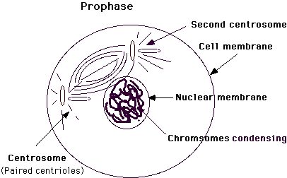
The stages of Mitosis and Meiosis
Mitosis: prophase
Meiosis 1: prophase 1

Slide 22
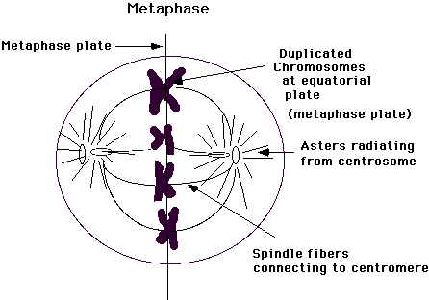
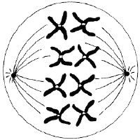
The stages of Mitosis and Meiosis
Mitosis: metaphase
Meiosis: metaphase 1

Slide 23
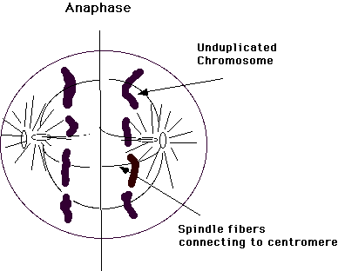
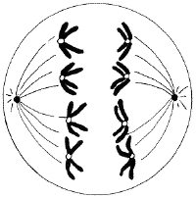
The stages of Mitosis and Meiosis
Mitosis: anaphase
Meiosis 1: anaphase I

Slide 24
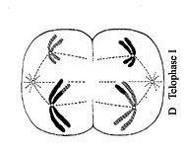
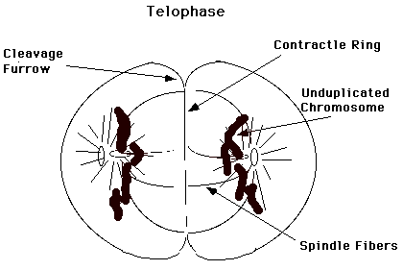
The stages of Mitosis and Meiosis
Mitosis: telophase
Meiosis 1: telophase I

Slide 25
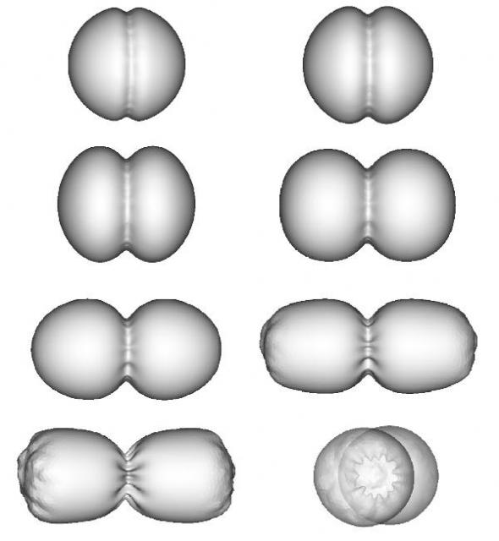
The stages of Mitosis and Meiosis
Cytokinesis: in both mitosis and meiosis, cytokinesis (literally “cytoplasm movement”) is the stage when the daughter cells separate to become truly individual cells. The cytoplasm and organelles are split between the daughter cells.

Slide 26
Recombination
The Law of Independent Assortment States that traits are inherited independently (separate genes for separate traits are passed independently of one another from parents to offspring.)
If genes are located on the same chromosome, how is it possible for one gene to end up in a gamete, but not another?

Slide 27
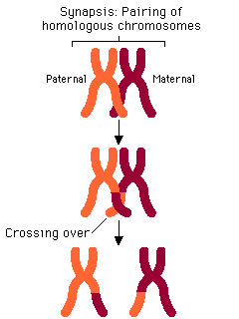
Recombination
During meiosis, a critical step takes place. When paired homologous chromosomes line up during metaphase, matching pieces on each chromosome can break off and swap places with each other.
This is called crossing over.

Slide 28
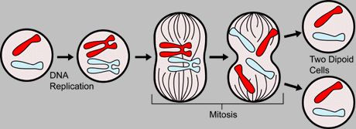
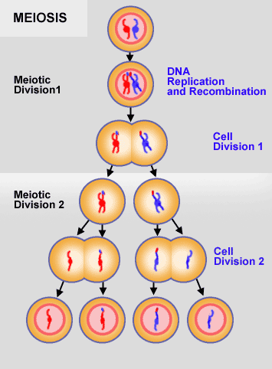
Mitosis
Meiosis

