Slide 1
Web Search
Choose starting search terms.
Evaluate results. If wrong or too vague, refine search terms.
Skim and survey the resulting pages.
Compare to find similar ideas and terms.
Create a new search based on new information.
Repeat, now taking detailed notes.

Slide 2
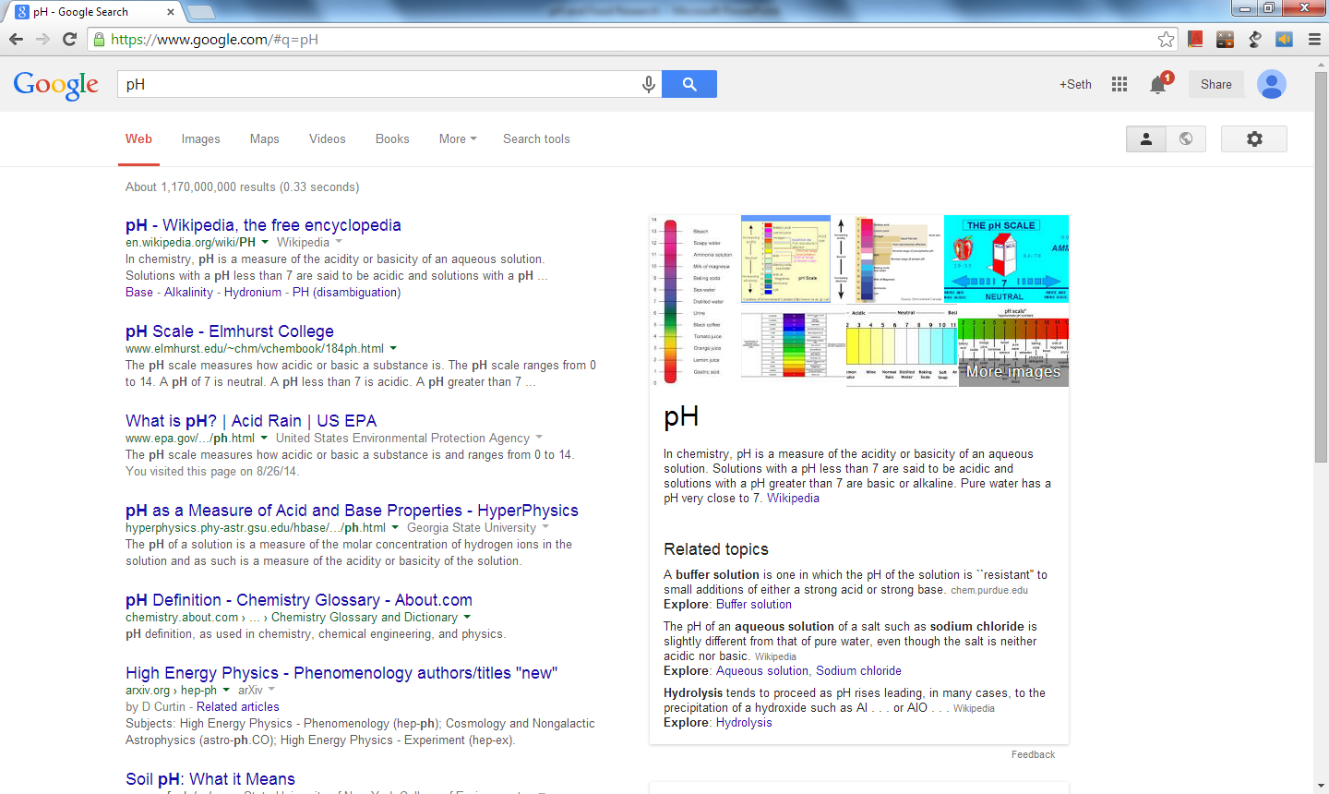
pH
Acidic, acidity, basic, measure, scale.

Slide 3
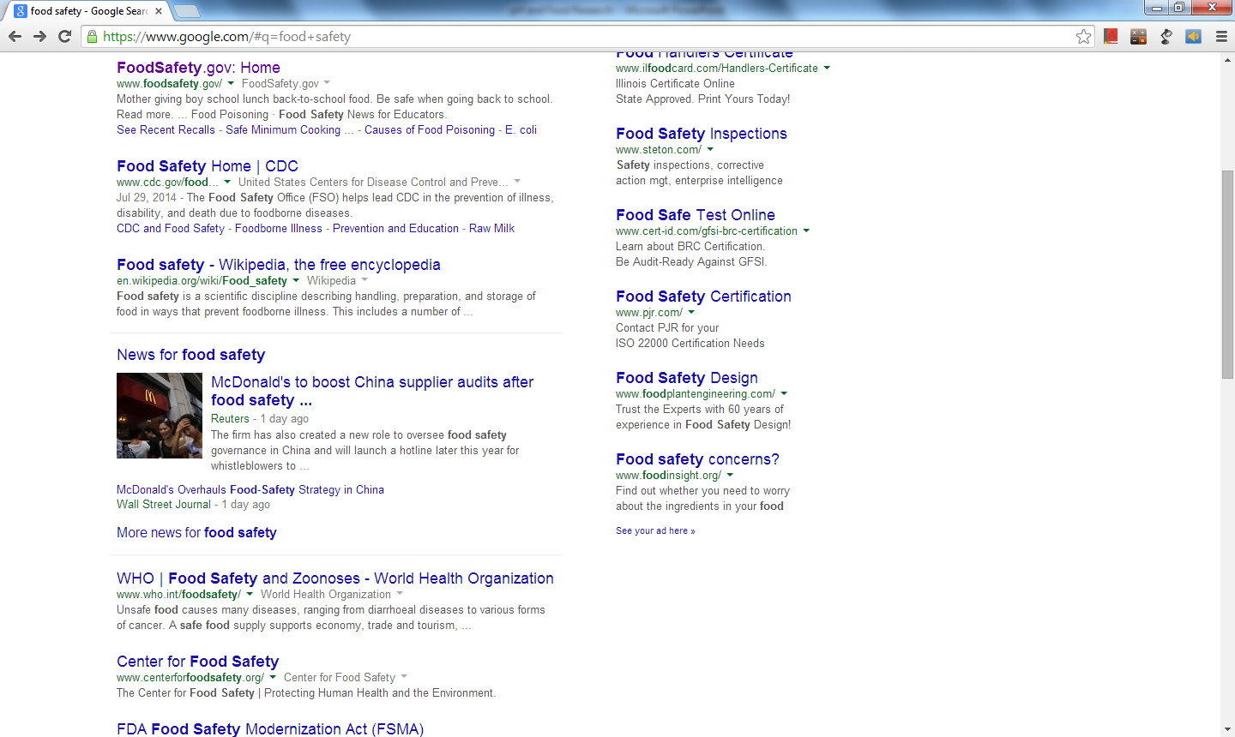
Food safety
Disease
Poisoning
E. Coli
Contamination

Slide 4
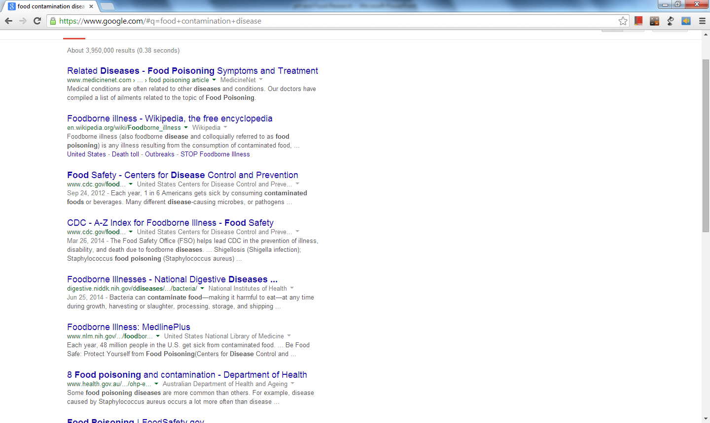
Food contamination disease
Microorganism
Pathogen
Safety

Slide 5
Food microorganism safety
Microorganism
Pathogen
Safety

Slide 6
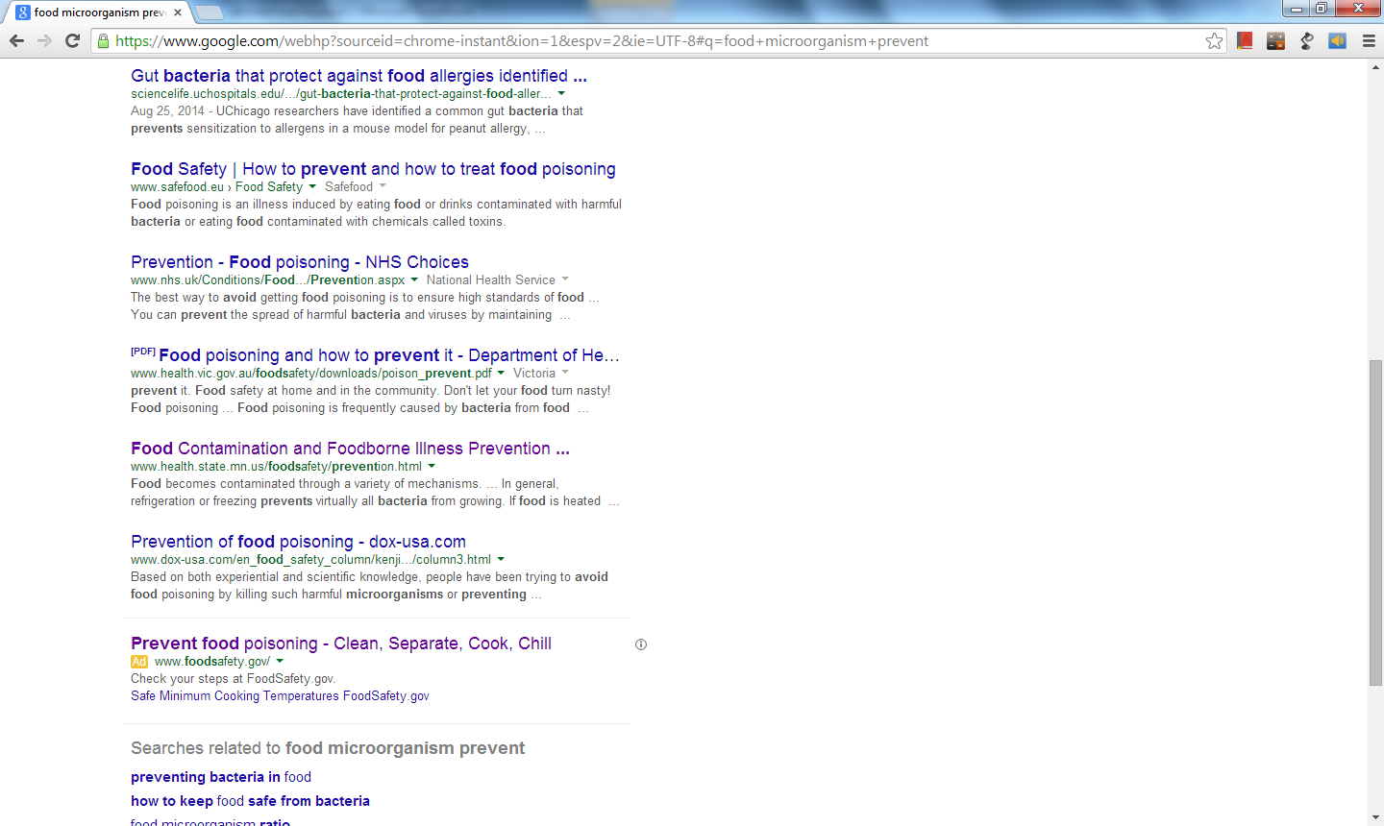
Food microorganism prevent
Heating
Freezing
Decontaminate

Slide 7
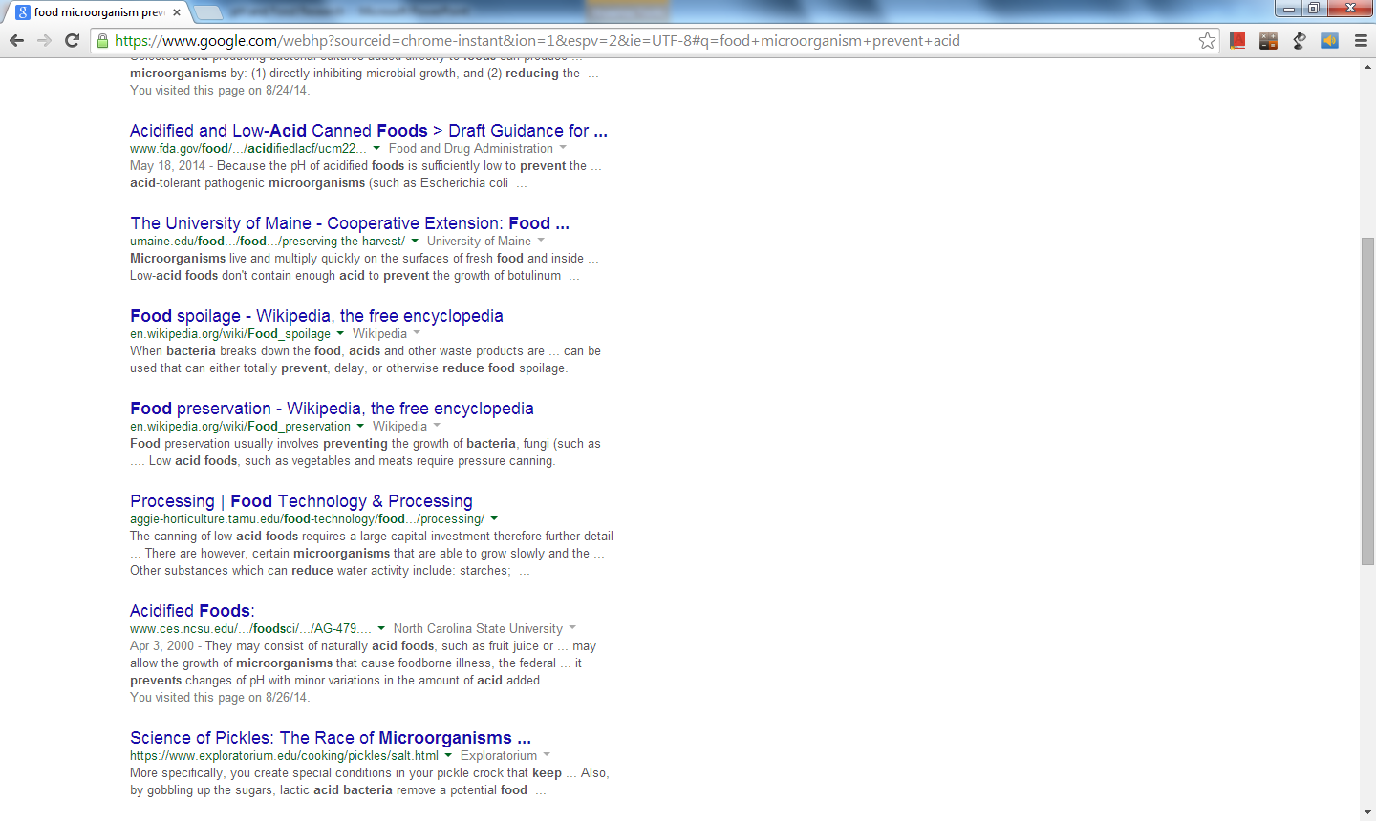
Food microorganism prevent acid

Slide 8
Research
pH
Food Safety
This is a way to measure how acidic something is.
Low pH (<7) is more acidic.
pH and Food safety
Very acidic solutions can kill bacteria (pH<4.6)
Using acids is called pickling.
Microorganisms growing on or in food can make it unsafe.
Food safety relies on eliminating microorganisms or slowing their growth rate.
Keeping food for long term storage in a safe way is preservation.

Slide 9
pH and Food Safety
What – acids can make foods safe for preservation. Solutions with low pH are acidic.
How - kill and/or injure microorganisms, especially below pH 4.6.
Why – Cultures with a history of pickling, and/or areas where refrigeration and canning are not available or undesirable.
When – When there is too much to preserve efficiently with other methods.
Who – Traditionalists, or people in poverty.
Where – Poor areas, or areas with a tradition of preserving foods.

