Slide 1
Chemistry
This is the science of how matter combines and changes.
Under normal conditions, matter is made of atoms.
Chemistry is therefore the study of how atoms combine and change.

Slide 2
Atomic Structure
Atoms are made of 3 particles:
Protons: +1 Charge
Neutrons: 0 charge
Electrons: -1 charge
Atoms contain different areas or structures:
Nucleus in the center – contains Protons and neutrons.
Electrons in areas surrounding the nucleus, called orbitals.

Slide 3
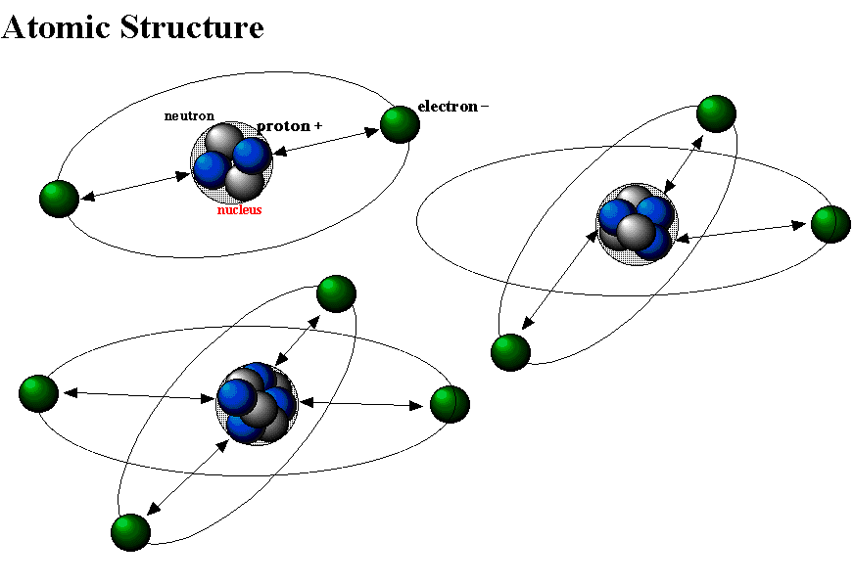
Atomic Structure

Slide 4
Electron orbitals
Electrons can only “fit” into certain areas around a nucleus.
These spaces are called Electron Orbitals. Each orbital can hold a limited number of electrons.

Slide 5
Elements
Atoms can be sorted into categories based on their structure.
These categories are the elements.
As protons are added to an atomic nucleus, a new element is formed.

Slide 6
Element features
Each element has a specific number of protons.
“Normal” elements have a number of electrons equal to the number of protons.
Elements can also have neutrons in various amounts.
Elements with unusual numbers of neutrons are called isotopes.

Slide 7
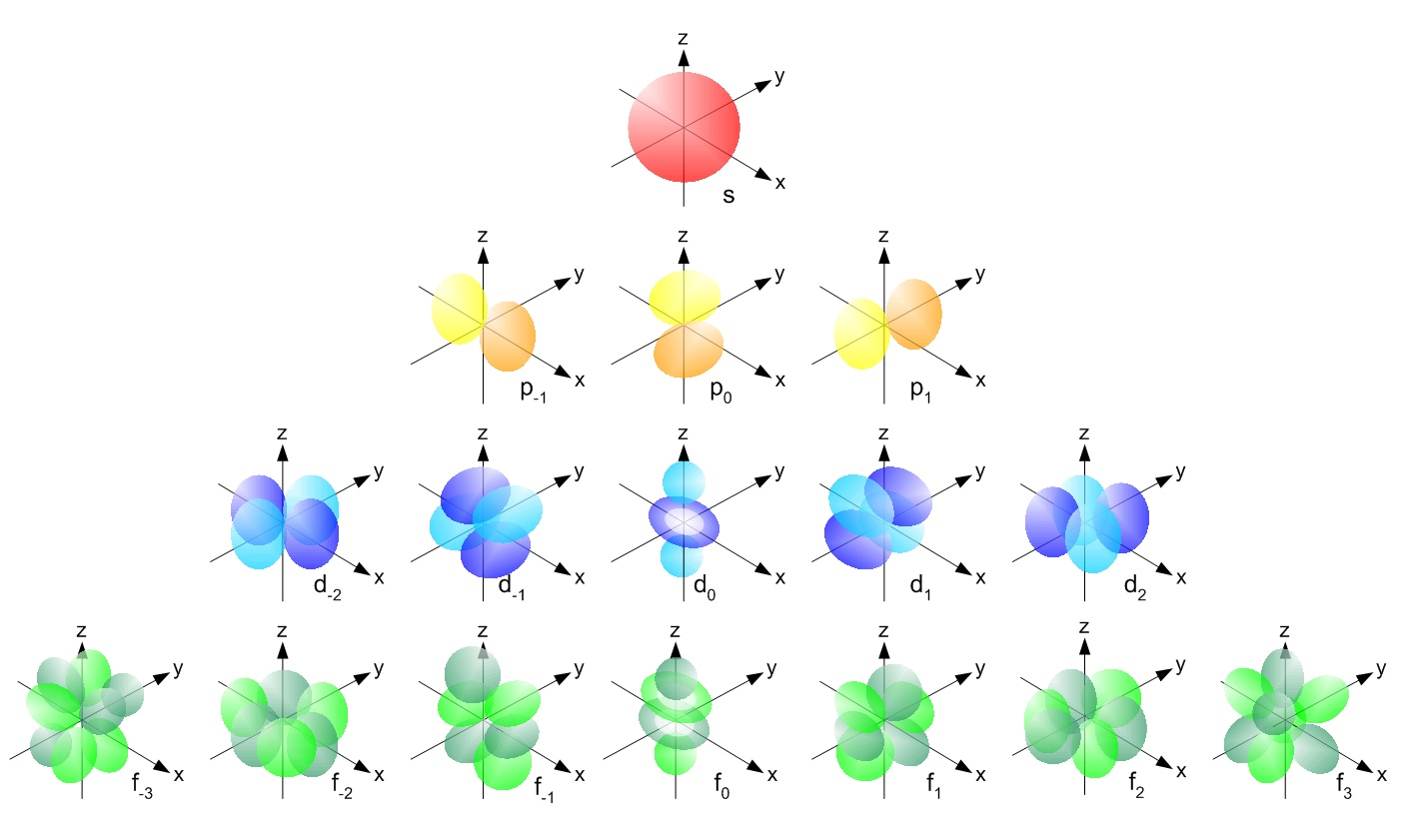
Atomic Stability
Atoms are the most stable when their outer-most orbital is completely full.

Slide 8
Valence Orbital
The outermost electron orbital is called the Valence Orbital or Valence Shell.
As valence orbitals get further from the nucleus, they can contain more electrons:
Orbital 1 – 2 electrons
Orbital 2 – 8 electrons if valence
Orbital 3 – 8 electrons if valence,
Orbital 4 – 8 electrons if valence, 16 if not
Orbital 5 – 8 electrons if valence, 16 if not
Orbital 6 – 8 electrons if valence, 32 if not
Orbital 7 – 8 electrons if valence, 32 if not

Slide 9
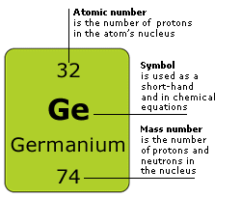
Periodic Table
Lists all known and proposed elements in a specific format and order.

Slide 10
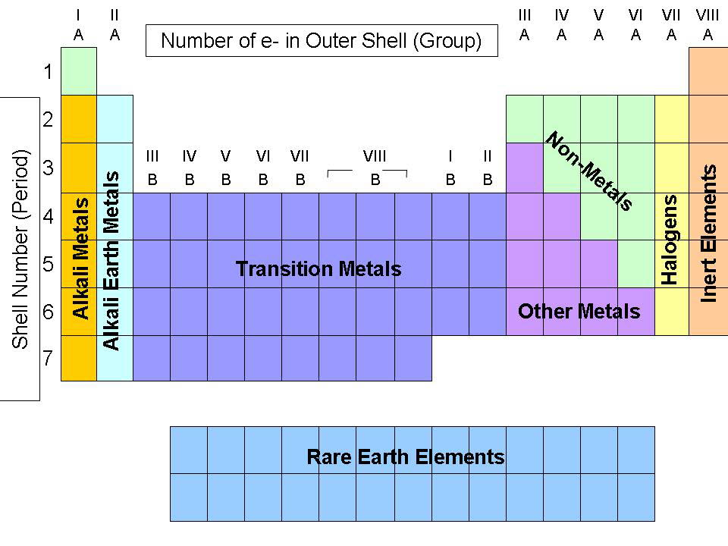
Groups
The columns on the periodic table indicate similar elements. They each have equal numbers of valence electrons.

Slide 11
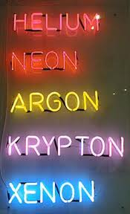
Noble/Inert Gases
The final column on the periodic table is the Inert/Nobel Gas/8th/18th group.
All the elements in this group have a full Valence Shell.
Since they are already stable, none of these elements will react with any other element.

Slide 12
All Other Groups
All other groups of elements on the Table can become stable by gaining, losing or sharing electrons in order to resemble the closest Noble Gas.

Slide 13
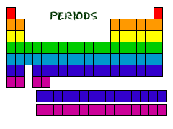
Periods
The Periods on the Table are the rows.
Each new row on the Table indicates a new shell of electrons is being filled.
All the elements in a period do not behave similarly.

Slide 14
Compounds
In order to become stable, unstable elements that aren’t Noble Gases steal, lose or share electrons to become like nearby Noble Gases.
The resulting accumulations of multiple atoms are compounds.
Compounds are also called molecules.

Slide 15
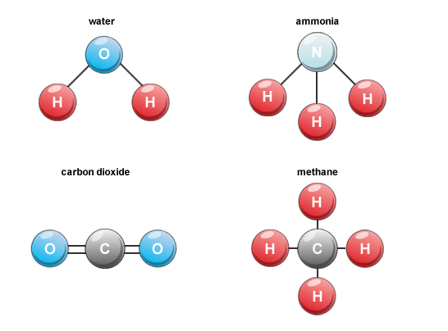
Drawing Compounds
Compounds can be drawn by writing the symbol for the elements, joined by lines that represent the pairs of electrons they share.

Slide 16
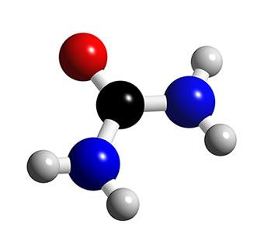
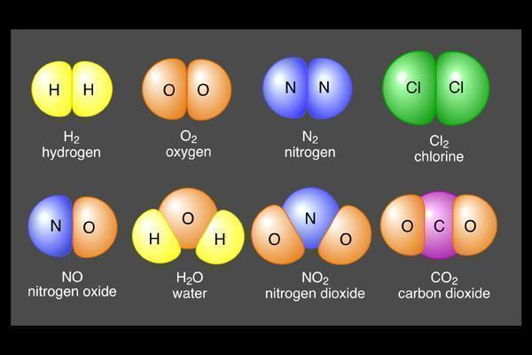
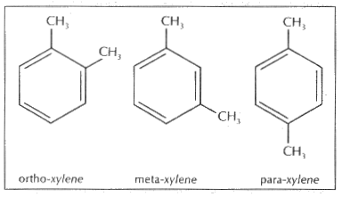
Drawing Compounds
Compounds can also be drawn in other ways…but we won’t use most of them for a while.

Slide 17
Reading Symbols
Each capital letter indicates an element’s symbol. When there is a lower case letter, it is a part of the symbol for the capital letter before it.
Be=Beryllium
H=Hydrogen
Na=Sodium
N=Nitrogen

Slide 18
Reading Simple Compounds
When there is a number to the lower right of an element, it means that the compound contains that many atoms of that element.
H₂O: Water has two hydrogen atoms and one oxygen atom.
H₂O₂: Hydrogen Peroxide has two hydrogen atoms and two oxygen atoms.
C₆H₁₂O₆: Glucose has six hydrogen atoms, twelve hydrogen atoms, and six oxygen atoms.

Slide 19
Simple Compounds Problem 1
How many different elements are in the following compound? How many atoms?
Ethanol: C₂H₆O

Slide 20
Simple Compounds Problem 2
How many different elements are in the following compound? How many atoms?
Tryptophan: C₁₁H₁₂N₂O₂

Slide 21
Simple Compounds Problem 3
How many different elements are in the following compound? How many atoms?

Slide 22
Simple Compounds Problem 3
How many different elements are in the following compound? How many atoms?
Silver Hexafluoroarsenate: AgAsF₆

Slide 23
Reading Complex Compounds
Sometimes there are groups of atoms in a compound that are in parentheses.
These are intended to be treated as a group.
Cu(ClO₃)₂: Copper Chlorate has an atom of copper bonded to two groups. Each group contains a chlorine atom and three oxygen atoms. In this atom, there is a total of:
1 copper atom
2 chlorine atoms
6 oxygen atoms

Slide 24
Complex Compounds Problem 1
How many different elements are in the following compound? How many atoms?
Aluminum Perchlorate: Al(ClO₄)₃

Slide 25
Complex Compounds Problem 2
How many different elements are in the following compound? How many atoms?
Titanium (II) sulfate: Ti₂(SO₄)₃

Slide 26
Complex Compounds Problem 3
How many different elements are in the following compound? How many atoms?
Lead (II) azide: Pb₂(N₃)₂

Slide 27
Reactions
A reaction occurs when atoms within nearby compounds rearrange themselves and switch places.
The compounds and atoms that you start with are the reactants.
The compounds and atoms you end with after the reaction are the products.

Slide 28
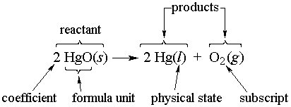
Reaction Equations
Reaction equations can show reactants, products, and give information about them. These equations can be read like compound formulas, but they can include coefficients to indicate how many there are of a given compound:

Slide 29
Balanced Reaction Equations
In a properly written equation, there must be equal numbers of atoms of an element on the product and reactant side:
H₂+O₂ → H₂O
There are two oxygen atoms on the reactant side, but only one on the product side. This is wrong.

Slide 30
Conservation of Mass
2H₂+O₂ → 2H₂O
In the properly balanced reaction, there are four hydrogen atoms on each side, and two oxygen atoms.
The fact that matter is never created or destroyed in a chemical reaction is known as the Law of Conservation of Matter or Mass.

Slide 31
Energy
When electrons are transferred or shared to create stable atoms, energy can be trapped in the bonds that hold compounds together.
Reactions that break high energy bonds and replace them with low energy bonds can release energy as heat. These are Exothermic Reactions.
Reactions that trap energy in bonds use up heat energy from the environment. These are Endothermic Reactions.

Slide 32
Conservation of Energy
In a chemical reaction, the total energy of the system is always the same before and after a reaction.
Energy is never created or destroyed.
This is known as Conservation of Energy.

Slide 33
Features of Compounds
Next up!
Why are some compounds solids when others are liquids or gases?
Why can some compounds mix and dissolve, but others can’t?
What are the rules for mixtures?
Why do some reactions happen, but not others?
What are the rules for solubility and phase changes?

